Slide 1
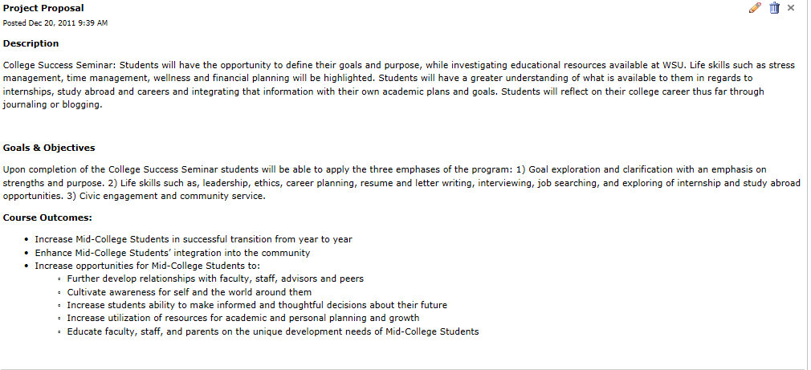
College Success Seminar Final Report
Original Proposal

Slide 2
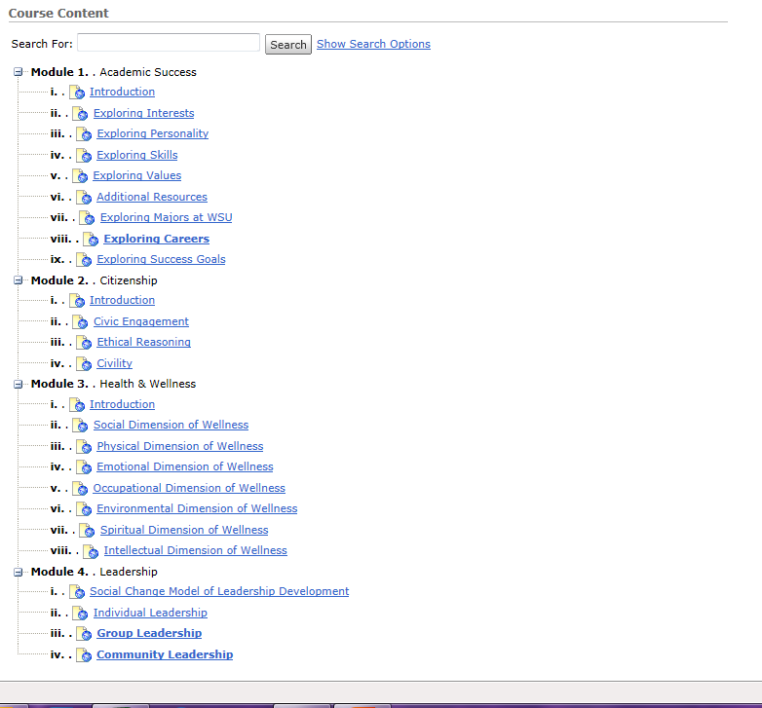
Outcomes Below is the course content outline for the College Success Seminar. The course is broken up into four modules: Academic Success, Citizenship, Health and wellness and Leadership. The report will outline how each module was created and give an overview of the content and use.

Slide 3
Module 1: Academic Success The Academic Success Module will allow students to explore four areas that contribute to their academic success: interests, personality, skills and values . In the first module entitled, “Exploring Interests,” the students are prompted to take an online assessment that organizes the student’s interest according to Holland Interest Types. After they read their results generated from the assessment, the student answers some reflection questions based on their results. The “Exploring Interests” module is very easy to do and takes only about 5 – 7 minutes to complete. Each module of the Academic Success module was built so that the student did everything online that it would not take them very long to complete. The second module, “Exploring Personality” prompts the student to first complete two online personality assessments. The first is based on Carl Jung’s Theory of Psychological types and the second is “True Colors.” The questions in the reflection section ask students to identify aspects of their personality that rang true for them after reading their results from both assessments. “Exploring Skills” is the third module and prompts the students to take iseek Skills Assessment and O*Net Skills Assessment. The website iseek is a Minnesota career and job resource website and O*Net is part of the American Job Center network. Both of these assessments allow the student to categorize skills they have and skills they would like to have when they graduate college. Then after they select many levels of skills the generated report list possible career fields that they should explore. Each career areas is a link that then gives you a summary report for the skills, abilities and education you would need to be success in that career. “Exploring Values” module is similar in pattern and style to the other three and begins with a online assessment, then goes into a few reflection questions. The remainder of this module allows the student to explore majors, careers and other resources at Winona State. The last exercise gives students information on how to craft success goals to help you be academically successful. The Academic Success module was developed in coordination with Warrior’s Success Center and their “Prepare to Declare” materials. GPS LifePlan (www.gpslifeplan.org )was also used to gather information regarding the most utilized on line assessments for students. The goal was to have the modules be quick and easy for students to accomplish and have all the assessments and reflections be online, so there was no printing and hard copies. The Academic Success module was designed to be used in an advisor/ advisee relationship where the advisor would have access to the online self-assessment through D2L. Then the advisor would be able to have a discussion during an advising session to discuss their progress toward their goals.

Slide 4
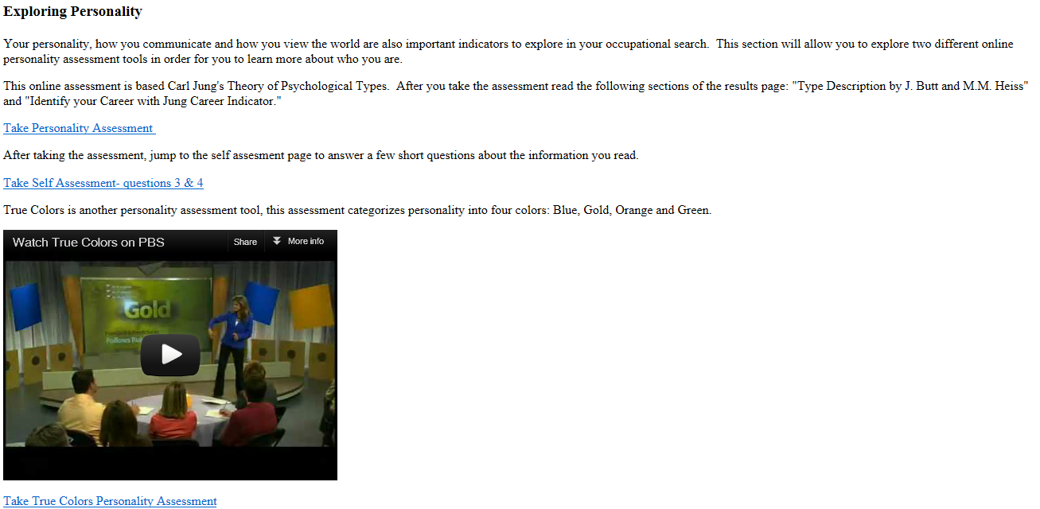
Academic Success Module Example-
Below is what the student would see in the introduction and “Exploring Personality” sections in the Academic Success Module.

Slide 5
Example of Module Content

Slide 6
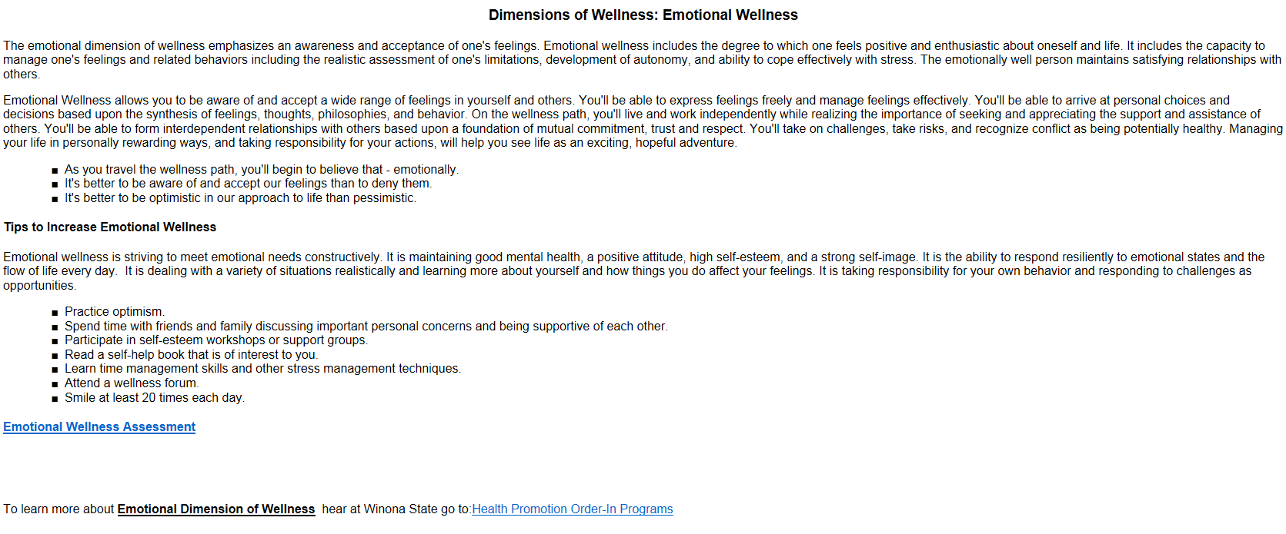
Example of Module Content

Slide 7
Individual Leadership Example of Module Content

